Slide 1
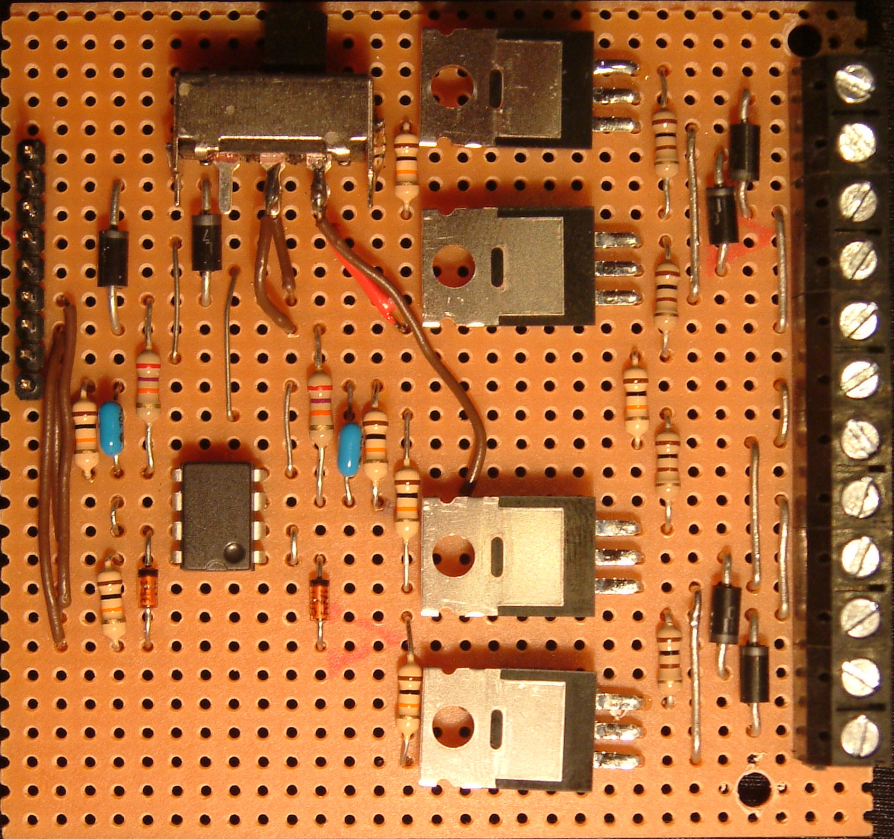
Quad Brushed Motor Driver / Dual Battery Minimum Voltage Sensor
Component Side
Dror & Itai Caspi, May 12, 2009
J2
J1
Q4
12
Right Out +
S1
9
D4
11
Right Out -
R7
R8
Vbat + Out
8
10
Left Out -
Right In
7
D3
Left In
6
D6
9
Left Out +
Rear In
5
D5
Q3
Front In
4
R6
Bat Sense Out
3
8
Bat 2 In +
5V In
2
R12
R5
7
Bat 2 In -
GND Out
1
R11
R10
R9
6
Bat 1 In -
C2
C1
R4
U1
5
Bat 1 In +
R3
Q2
4
Rear Out -
D8
D7
R13
D2
3
Rear Out +
R2
D1
2
R1
Front Out +
Q1
1
Front Out -

Slide 2
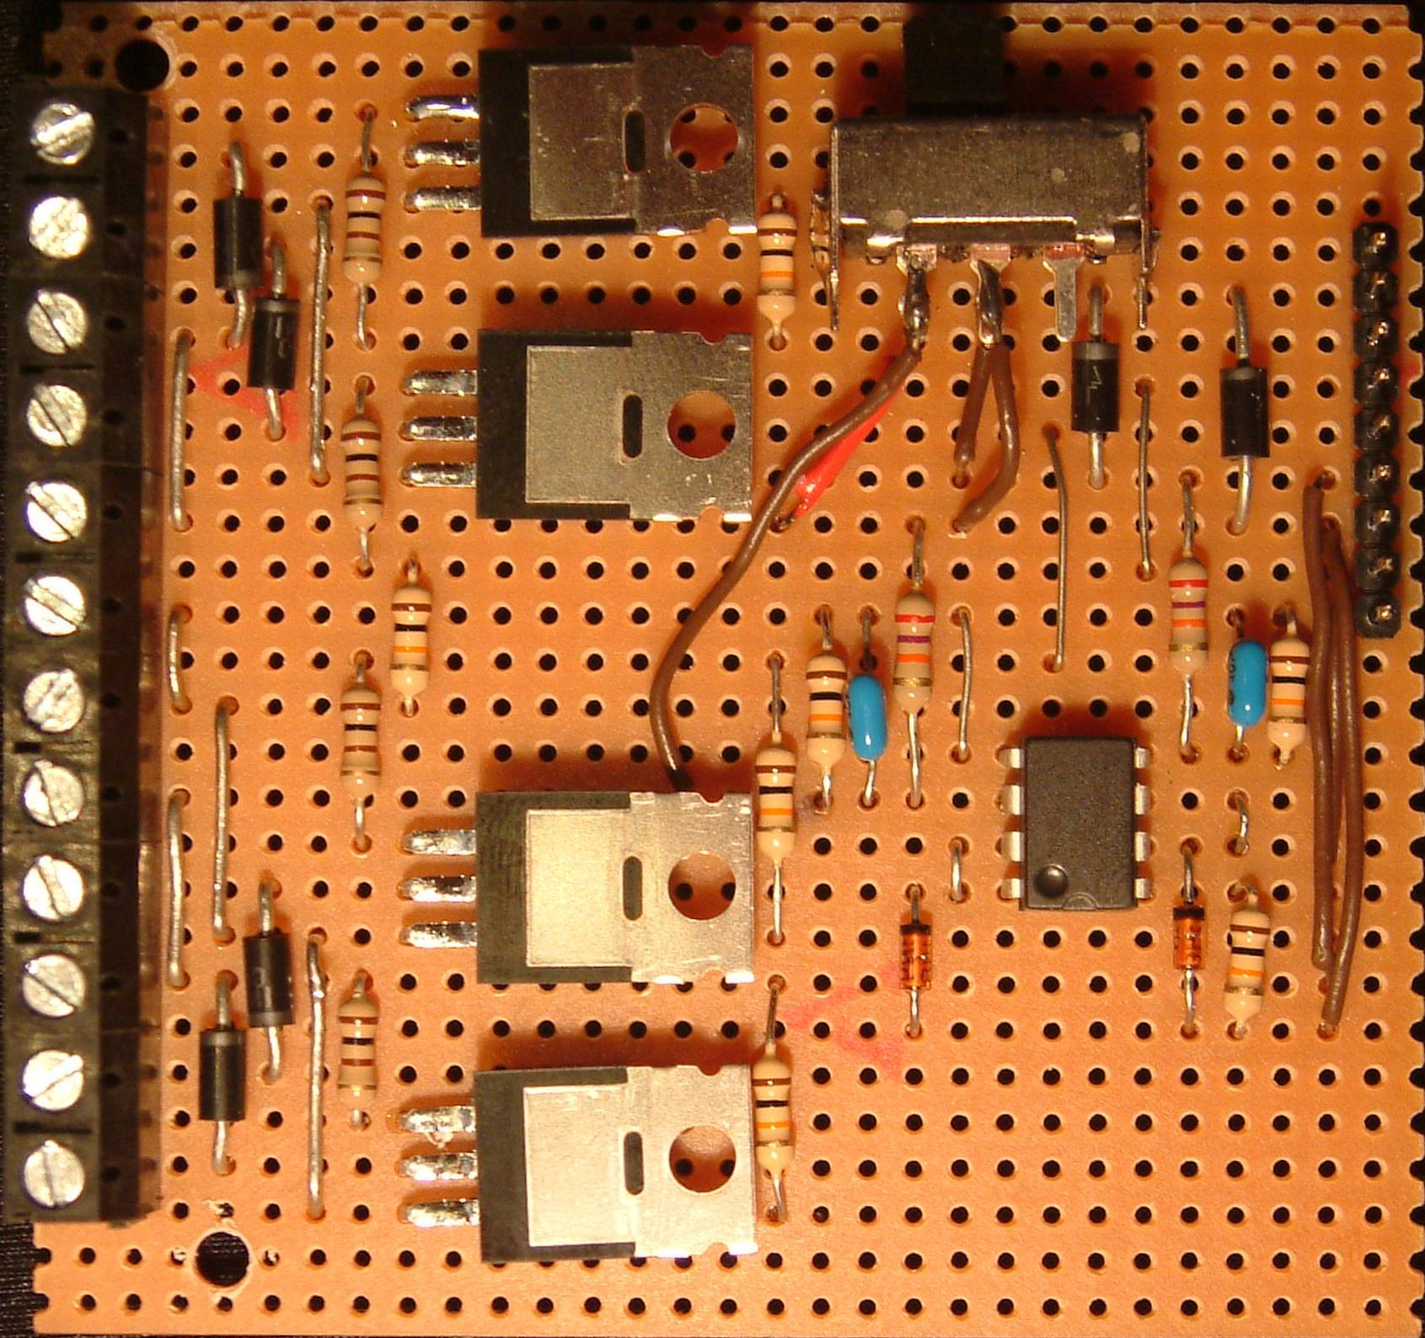
Quad Brushed Motor Driver / Dual Battery Minimum Voltage Sensor
Back Side
Dror & Itai Caspi, May 12, 2009
J2
Right Out +
12
Q4
J1
S1
Right Out -
11
D4
9
R8
R7
Left Out -
10
8
Vbat + Out
D3
7
Right In
Left Out +
9
D6
6
Left In
Q3
D5
5
Rear In
R6
4
Front In
Bat 2 In +
8
3
Bat Sense Out
Bat 2 In -
7
R5
R12
2
5V In
R10
1
GND Out
R11
Bat 1 In -
6
R9
C2
R4
C1
Bat 1 In +
5
U1
R3
Rear Out -
4
Q2
D7
D8
Rear Out +
3
D2
R13
2
D1
R2
Front Out +
R1
Front Out -
1
Q1

